Slide 1
Lecture
Budgetary Planning
10
L.O. 22-1: Effective budgeting and the master budget
L.O. 22-2: Sales, production, and direct materials budgets
L.O. 22-3: Direct labor, manufacturing overhead, and S&A expense budgets
L.O. 22-4: Cash budget and budgeted balance sheet
L.O. 22-5: Budgeting in non-manufacturing companies

Slide 2
Learning Objective 22-1
Effective Budgeting and
the Master Budget

Slide 3
Outline
Budgeting and accounting
Benefits of budgeting
Effective budgeting essentials
Master budget

Slide 4
Budgeting
Budget: written statement of management’s plans for a specified future time period, expressed in financial terms.
Primary method of communicating agreed-upon objectives throughout the organization
Promotes efficiency
Control device - important basis for performance evaluation once adopted

Slide 5
Budgeting and Accounting
Historical accounting data on revenues and expenses help in formulating future budgets
Accountants normally responsible for presenting management’s budgeting goals in financial terms
Budget and its administration are the responsibility of management

Slide 6
Benefits of Budgeting
Primary benefits of budgeting:
Requires all levels of management to plan ahead.
Provides definite objectives for evaluating performance.
Creates an early warning system for potential problems.
Facilitates coordination of activities within the business.
Results in greater management awareness of the entity’s overall operations.
It motivates personnel throughout organization to meet planned objectives.

Slide 7
Benefits of Budgeting
Question
Which of the following is not a benefit of budgeting?
a. Management can plan ahead
b. An early warning system is provided for potential problems
c. It enables disciplinary action to be taken at every level of responsibility
d. The coordination of activities is facilitated

Slide 8
Essentials of Effective Budgeting
Sound organizational structure
Research and analysis with realistic goals
Accepted by all levels of management

Slide 9
Essentials of Effective Budgeting
LENGTH OF THE BUDGET PERIOD
May be prepared for any period of time.
Most common - one year.
Supplement with monthly and quarterly budgets.
Different budgets may cover different time periods.
Long enough to provide an attainable goal and minimize seasonal or cyclical fluctuations.
Short enough for reliable estimates.

Slide 10
Essentials of Effective Budgeting
THE BUDGETING PROCESS
Base budget goals on past performance
Collect data from organizational units.
Begin several months before end of current year.
Develop budget within the framework of a sales forecast.
Shows potential industry sales.
Shows company’s expected share.

Slide 11
Essentials of Effective Budgeting
THE BUDGETING PROCESS
Factors considered in sales forecasting:
General economic conditions
Industry trends
Market research studies
Anticipated advertising and promotion
Previous market share
Price changes
Technological developments

Slide 12
Essentials of Effective Budgeting
BUDGETING AND HUMAN BEHAVIOR
The process by which the budget is developed and administered can have a significant impact on human behavior.
Top-down approach – the budget is developed by top management and then dictated to lower-level managers.
Bottom-to-top approach – each level of management should be invited to participate.
Participative budgeting

Slide 13
Essentials of Effective Budgeting
PARTICIPATIVE BUDGETING
Advantages
Disadvantages
More accurate budget estimates because lower level managers have more detailed knowledge of their area.
Tendency to perceive process as fair due to involvement of lower level management.
Considered fair and achievable by managers while still meeting corporate goals.
Can be time consuming and costly.
Can foster budgetary “gaming” through budgetary slack (i.e. underestimate budgetary goals)

Slide 14
Essentials of Effective Budgeting
BUDGETING AND LONG-RANGE PLANNING
Three basic differences:
Time period involved
Emphasis
Amount of detail presented

Slide 15
Essentials of Effective Budgeting
Question
The essentials of effective budgeting do not include:
a. Top-down budgeting
b. Management acceptance
c. Research and analysis
d. Sound organizational structure

Slide 16
The Master Budget
Set of interrelated budgets that constitutes a plan of action for a specified time period.
Contains two classes of budgets:
Operating budgets.
Financial budgets.
Individual budgets that result in the preparation of the budgeted income statement (establish goals for sales and production personnel)

Slide 17
The Master Budget
Set of interrelated budgets that constitutes a plan of action for a specified time period.
Contains two classes of budgets:
Operating budgets.
Financial budgets.
The capital expenditures budget, the cash budget, and the budgeted balance sheet (focus primarily on cash needs to fund operations and capital expenditures)

Slide 18
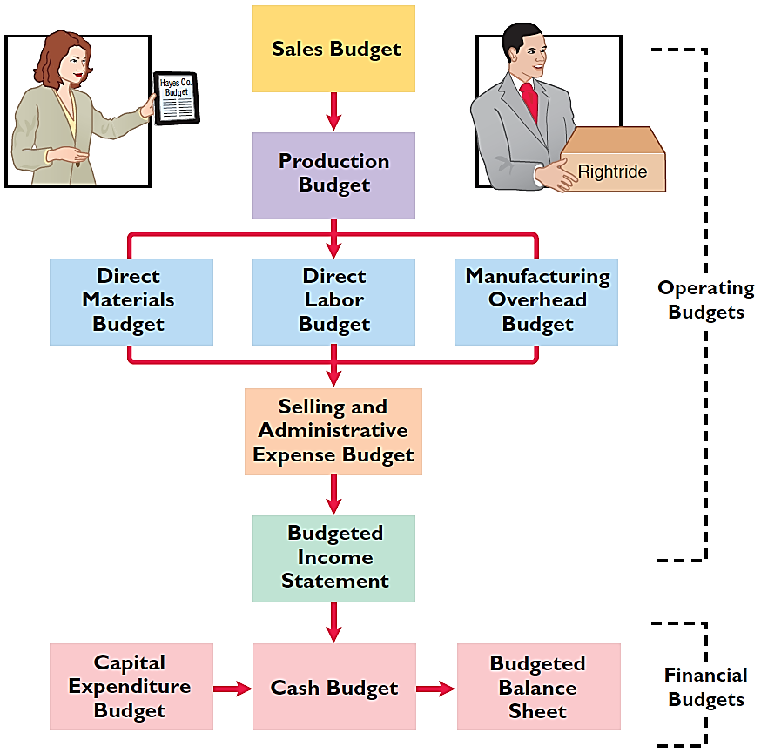
The Master Budget

Slide 19
DO IT! 1: Budget Terminology
Questions 1 and 2
Use this list of to complete the sentences that follow.
Long-range planning Participative budgeting
Sales forecast Operating budgets
Master budget Financial budgets
A _________ shows potential sales for the industry and a company’s expected share of such sales.
________ are used as the basis for the preparation of the budgeted income statement.

Slide 20
DO IT! 1: Budget Terminology
Answers 1 and 2
Use this list of to complete the sentences that follow.
Long-range planning Participative budgeting
Sales forecast Operating budgets
Master budget Financial budgets
A sales forecast shows potential sales for the industry and a company’s expected share of such sales.
Operating budgets are used as the basis for the preparation of the budgeted income statement.

Slide 21
DO IT! 1: Budget Terminology
Questions 3 and 4
Use this list of to complete the sentences that follow.
Long-range planning Participative budgeting
Sales forecast Operating budgets
Master budget Financial budgets
The __________ is a set of interrelated budgets that constitutes a plan of action for a specified time period.
__________ identifies long-term goals, selects strategies to achieve these goals, and develops policies and plans to implement the strategies.

Slide 22
DO IT! 1: Budget Terminology
Answers 3 and 4
Use this list of to complete the sentences that follow.
Long-range planning Participative budgeting
Sales forecast Operating budgets
Master budget Financial budgets
The master budget is a set of interrelated budgets that constitutes a plan of action for a specified time period.
Long-range planning identifies long-term goals, selects strategies to achieve these goals, and develops policies and plans to implement the strategies.

Slide 23
DO IT! 1: Budget Terminology
Questions 5 and 6
Use this list of to complete the sentences that follow.
Long-range planning Participative budgeting
Sales forecast Operating budgets
Master budget Financial budgets
Lower-level managers are more likely to perceive results as fair and achievable under a _________ approach.
_________ focus primarily on the cash resources needed to fund expected operations and planned capital expenditures.

Slide 24
DO IT! 1: Budget Terminology
Questions 5 and 6
Use this list of to complete the sentences that follow.
Long-range planning Participative budgeting
Sales forecast Operating budgets
Master budget Financial budgets
Lower-level managers are more likely to perceive results as fair and achievable under a participative budgeting approach.
Financial budgets focus primarily on the cash resources needed to fund expected operations and planned capital expenditures.

Slide 25
Learning Objective 22-2
Sales, Production, and
Direct Materials Budgets

Slide 26
Outline
Sales budget
Production budget
Direct materials budget

Slide 28
Sales Budget
First budget prepared.
Derived from the sales forecast.
Management’s best estimate of sales revenue for the budget period.
Every other budget depends on the sales budget.
Prepared by multiplying expected unit sales volume for each product times anticipated unit selling price.

Slide 29
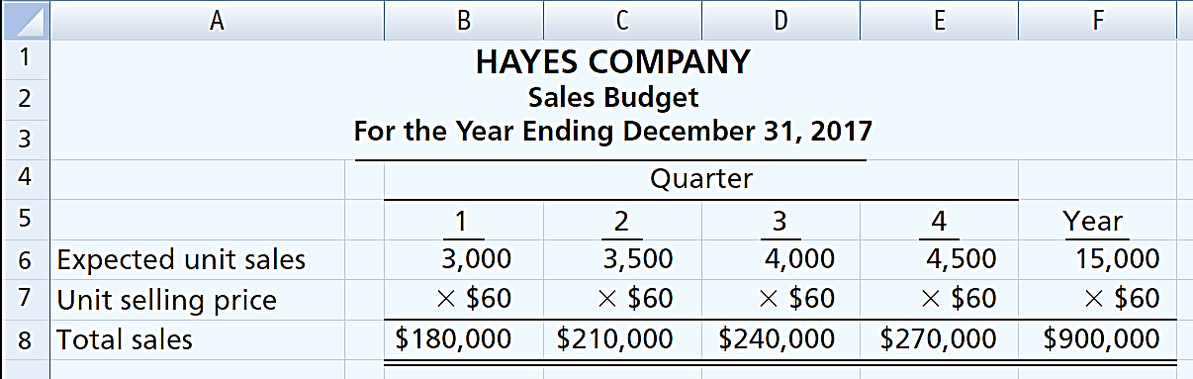
Sales Budget
Illustration – Hayes Company
Expected sales volume: 3,000 units in the first quarter with 500-unit increases in each succeeding quarter.
Sales price: $60 per unit.

Slide 30

Production Budget
Shows units that must be produced to meet anticipated sales.
Derived from sales budget plus the desired change in ending finished goods inventory.
Essential to have a realistic estimate of ending inventory.

Slide 31
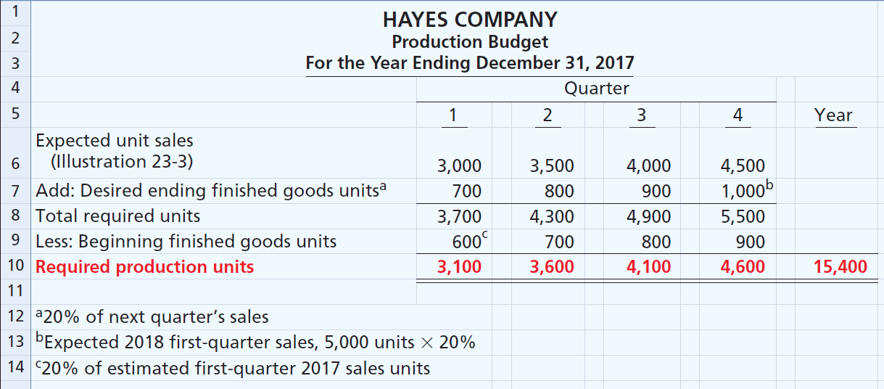
Production Budget
Hayes Co. believes it can meet future sales needs with an ending inventory of 20% of next quarter’s budgeted sales volume.

Slide 32
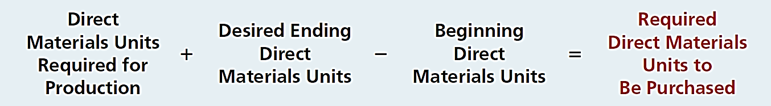
Direct Materials Budget
Shows both the quantity and cost of direct materials to be purchased.
Formula for direct materials quantities:
Illustration 23-6
Budgeted cost of direct materials to be purchased = required units of direct materials x anticipated cost per unit.
Inadequate inventories could result in temporary shutdowns of production.

Slide 33
Direct Materials Budget
Illustration – Hayes Company
Because of its close proximity to suppliers,
Hayes Company maintains an ending inventory of raw materials equal to 10% of the next quarter’s production requirements.
The manufacture of each product requires 2 pounds of raw materials, and the expected cost per pound is $4.
Assume that the desired ending direct materials amount is 1,020 pounds for the fourth quarter of 2017.

Slide 34
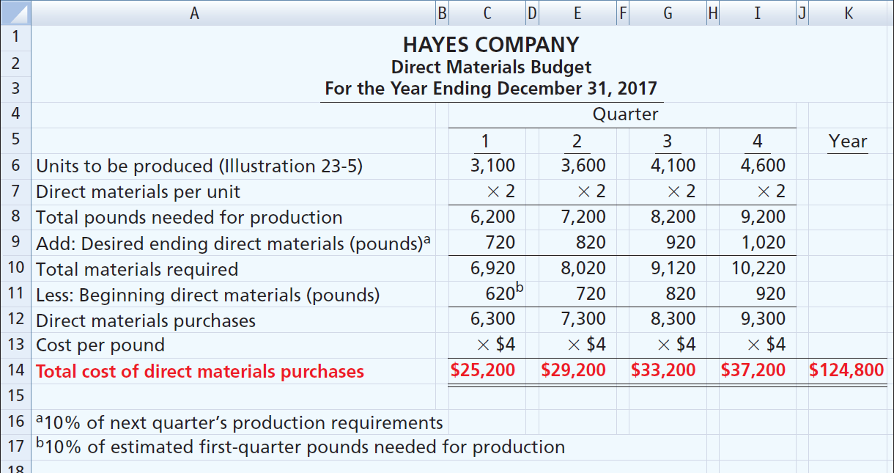
Direct Materials Budget

Slide 35
Learning Objective 22-3
Direct Labor, Manufacturing Overhead, and S&A Expense Budgets

Slide 36
Outline
Direct labor budget
Manufacturing overhead budget
Selling & administrative expense budget
Budgeted income statement

Slide 38

Direct Labor Budget
Shows both the quantity of hours and cost of direct labor necessary to meet production requirements.
Critical in maintaining a labor force that can meet expected production.
Total direct labor cost formula:

Slide 39
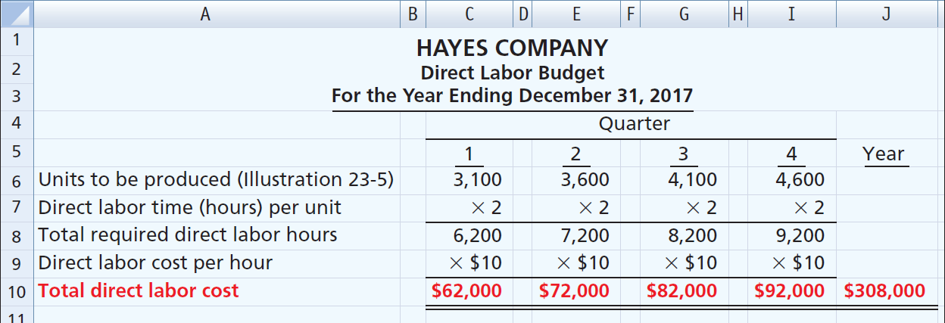
Direct Labor Budget
Illustration: Direct labor hours are determined from the production budget. At Hayes Company, two hours of direct labor are required to produce each unit of finished goods. The anticipated hourly wage rate is $10.

Slide 40
Manufacturing Overhead Budget
Shows the expected manufacturing overhead costs for the budget period.
Distinguishes between fixed and variable overhead costs.

Slide 41
Manufacturing Overhead Budget
Illustration: Hayes Company expects variable costs to fluctuate with production volume on the basis of the following rates per direct labor hour:
indirect materials $1.00,
indirect labor $1.40,
utilities $0.40,
maintenance $0.20.
Hayes also recognizes that some maintenance is fixed. The amounts reported for fixed costs are assumed.

Slide 42
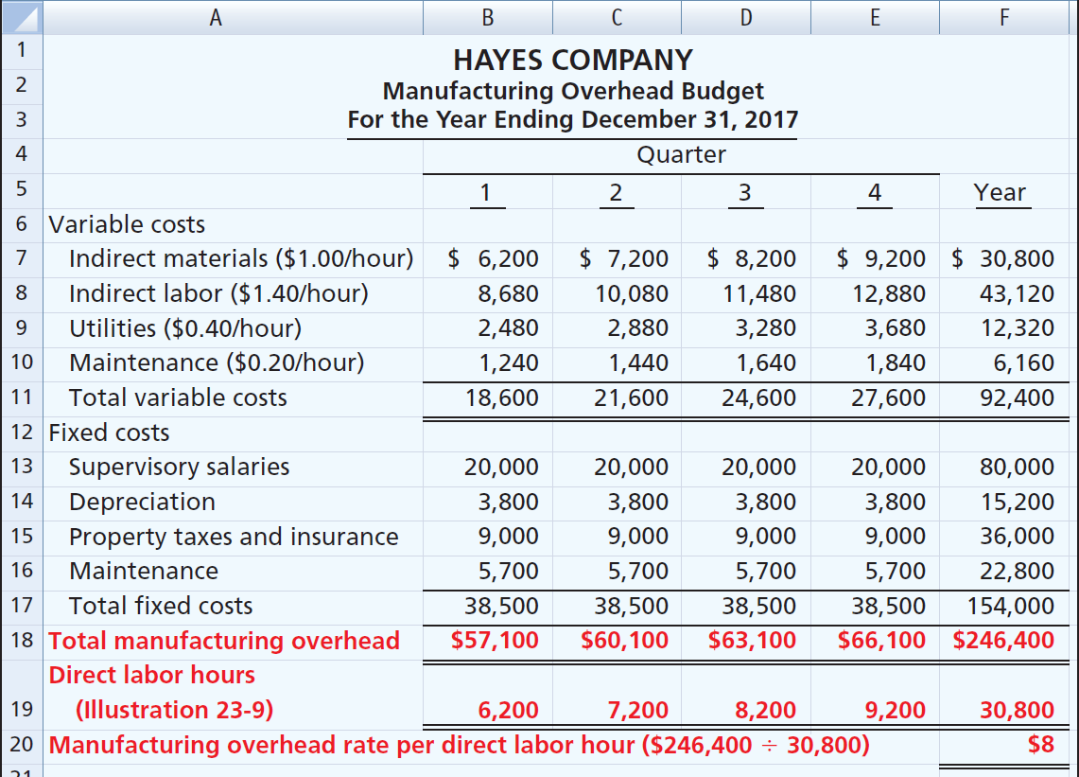

Slide 43
Selling & Administrative Expense Budget
Projection of anticipated operating expenses.
Distinguishes between fixed and variable costs.
Illustration: Variable expense rates per unit of sales are sales commissions $3 and freight-out $1. Variable expenses per quarter are based on the unit sales from the sales budget. Hayes expects sales in the first quarter to be 3,000 units. Fixed expenses are based on assumed data.

Slide 44
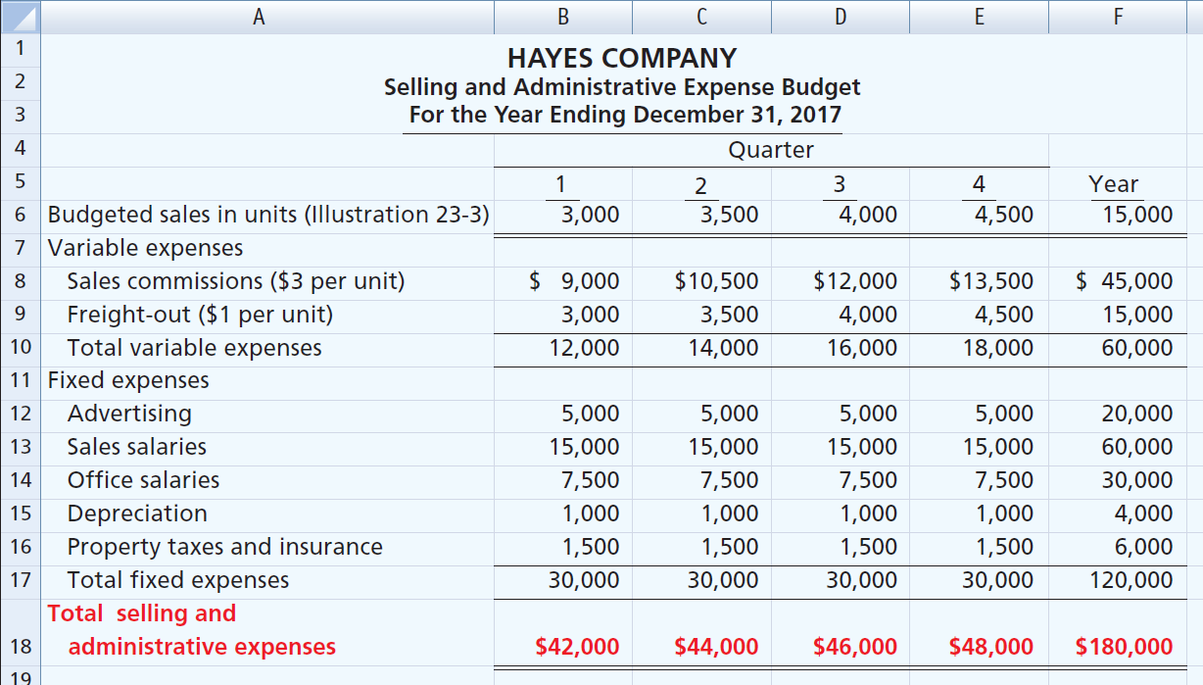

Slide 45
Budgeted Income Statement
Important end-product of the operating budgets.
Indicates expected profitability of operations.
Provides a basis for evaluating company performance.
Prepared from the operating budgets:
Sales
Direct Materials
Direct Labor
Manufacturing Overhead
Selling & Administrative Expense

Slide 46
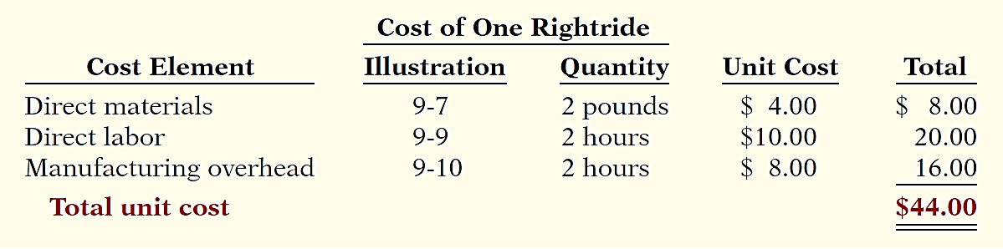
Budgeted Income Statement
Illustration: To find the cost of goods sold, it is first necessary to determine the total unit cost of producing one product, as follows.
Second, determine Cost of Goods Sold by multiplying units sold times unit cost: 15,000 units x $44 = $660,000

Slide 47
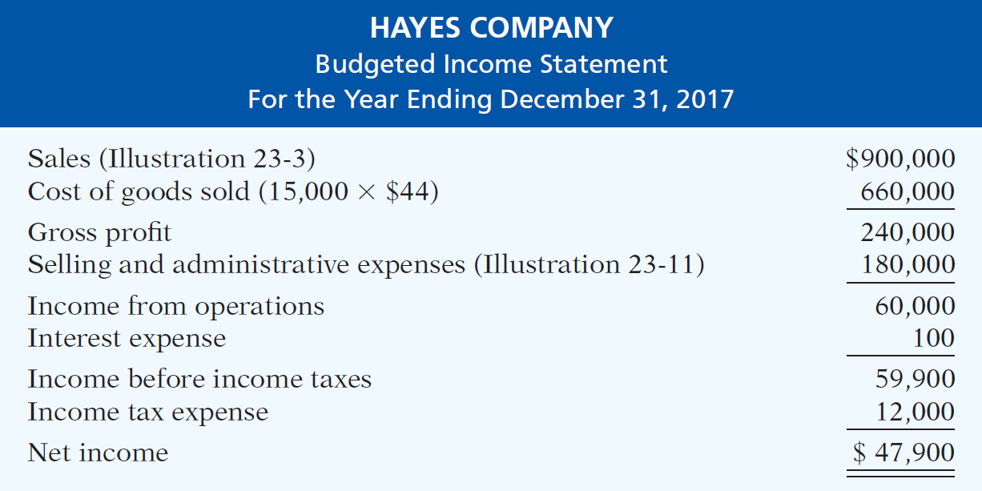
Budgeted Income Statement
Illustration: All data for the income statement come from the individual operating budgets except the following: (1) interest expense is expected to be $100, and (2) income taxes are estimated to be $12,000.

Slide 48
Budgeted Income Statement
Question
Each of the following budgets is used in preparing the budgeted income statement except the:
a. Sales budget.
b. Selling and administrative budget.
c. Capital expenditure budget.
d. Direct labor budget.

Slide 49
DO IT! 3: Budgeted Income Statement
Soriano Company is preparing its budgeted income statement for 2020. It estimates sales to be 1,200,000 units with total sales budget $61,500,000.
Soriano budgets 3.0 pounds of direct materials per unit, direct materials cost at $5 per pound; 0.5 hours of direct labor per unit, labor costs at $15 per hour; and manufacturing overhead at $25 per direct labor hour. Its budgeted selling and administrative expenses for 2020 are $12,000,000.
a. Calculate the budgeted total unit cost.
b. Prepare the budgeted income statement for 2020.

Slide 50
DO IT! 3: Budgeted Income Statement
a. Calculate the budgeted total unit cost.
Cost Element | Quantity | Unit Cost | Total
Direct materials | 3.0 pounds | $ 5 | $ 15.00
Direct labor | .5 hours | 15 | 7.50
Manufacturing overhead | .5 hours | 25 | 12.50
Total unit cost |  |  | $ 35.00

Slide 51
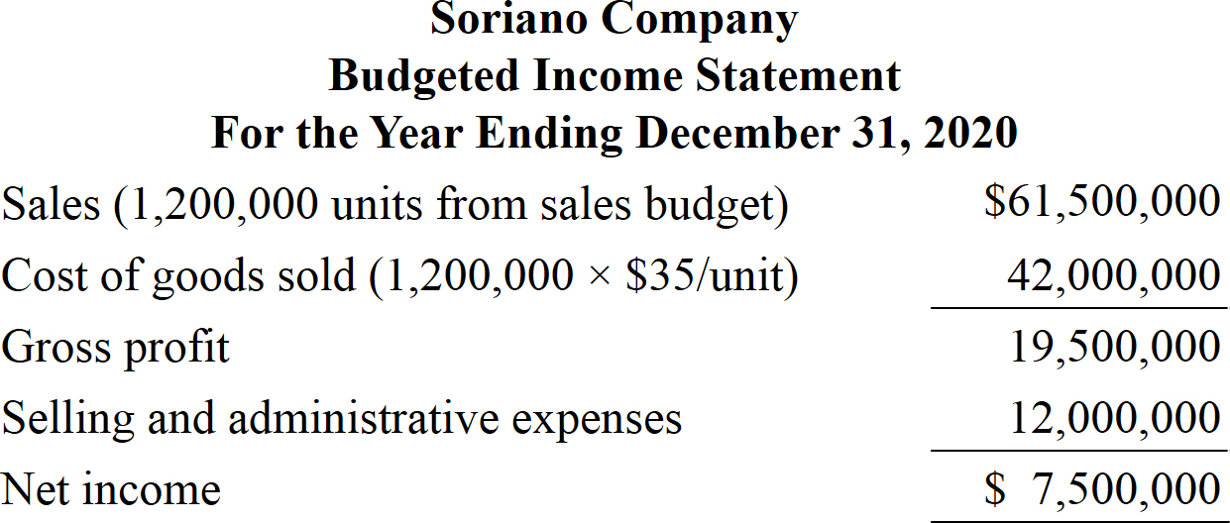
DO IT! 3: Budgeted Income Statement
b. Prepare the budgeted income statement for 2020.

Slide 52
Learning Objective 22-4
Cash Budget and
Budgeted Balance Sheet

Slide 53
Outline
Cash budget
Budgeted balance sheet

Slide 55
Cash Budget
Shows anticipated cash flows.
Often considered to be the most important output in preparing financial budgets.
Contains three sections:
Cash Receipts
Cash Disbursements
Financing

Slide 56
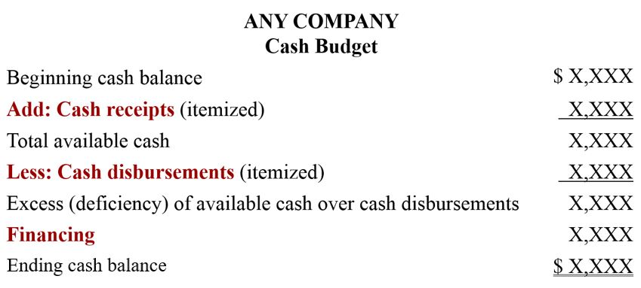
Cash Budget

Slide 57
Cash Budget
Cash receipts section
Expected receipts from the principal sources of revenue (i.e. cash sales and collections on credit sales).
Other receipts such as dividends or proceeds from plant assets.
Cash disbursements section
Expected cash payments for direct materials, direct labor, manufacturing overhead, and selling and administrative expenses.
Other payments such as income or investments.
Financing section
Expected borrowings and repayments of borrowed funds plus interest.

Slide 58
Cash Budget
Must prepare in sequence.
Ending cash balance of one period is the beginning cash balance for the next.
Data obtained from other budgets and from management.
Often prepared for the year on a monthly basis.
Contributes to more effective cash management.
Shows managers the need for additional financing before actual need arises.
Indicates when excess cash will be available

Slide 59
Cash Budget
Illustration – Hayes Company Estimations
On January 1, 2017, cash balance is expected to be $38,000. Hayes wishes to maintain a balance of at least $15,000.
Sales: 60% are collected in the quarter sold and 40% are collected in the following quarter. Accounts receivable of $60,000 at December 31, 2016, are expected to be collected in full in the first quarter of 2017.
Short-term investments are expected to be sold for $2,000 cash in the first quarter.

Slide 60
Cash Budget
Illustration – Hayes Company Estimations
Direct materials: 50% are paid in the quarter purchased and 50% are paid in the following quarter. Accounts payable of $10,600 at December 31, 2016, are expected to be paid in full in the first quarter of 2017.
Direct labor: 100% is paid in the quarter incurred.
Manufacturing overhead and selling and administrative expenses: all items except depreciation are paid in the quarter incurred.

Slide 61
Cash Budget
Illustration – Hayes Company Estimations
Management plans to purchase a truck in the second quarter for $10,000 cash.
Hayes makes equal quarterly payments of its estimated annual income taxes.
Loans are repaid in the earliest quarter in which there is sufficient cash (that is, when the cash on hand exceeds the $15,000 minimum required balance).

Slide 62
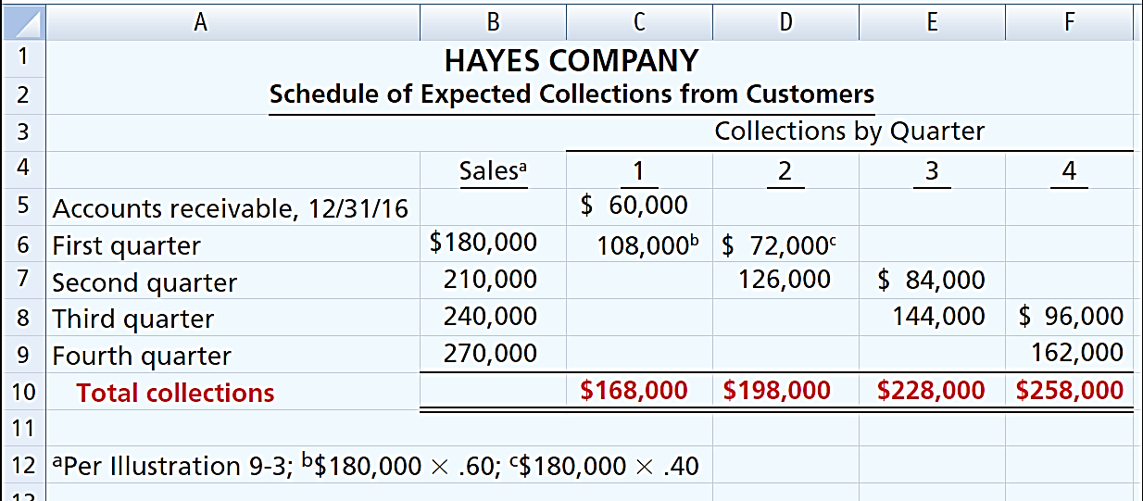
Cash Budget
Illustration – Prepare a schedule of collections from customers.

Slide 63
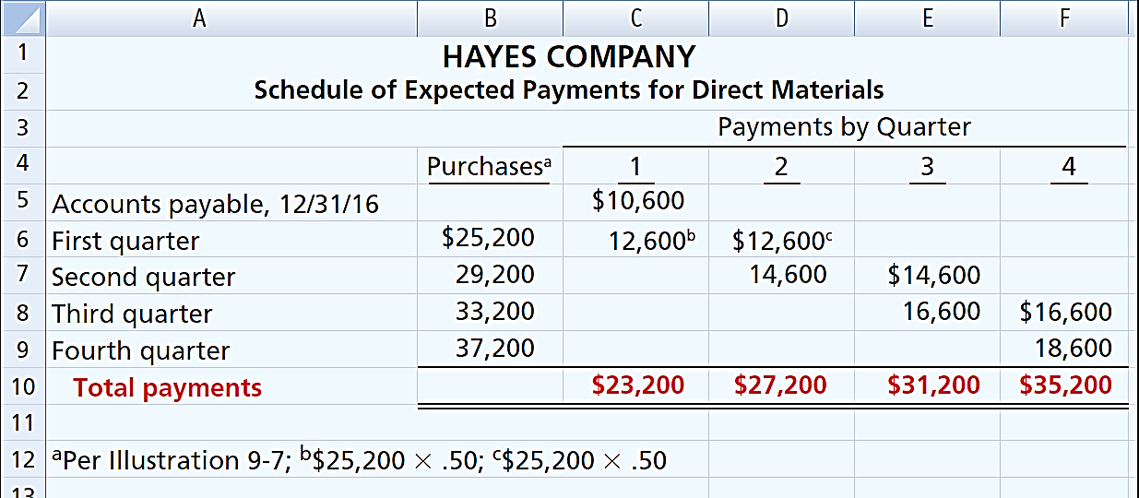
Cash Budget
Illustration – Prepare a schedule of cash payments for direct materials.

Slide 64
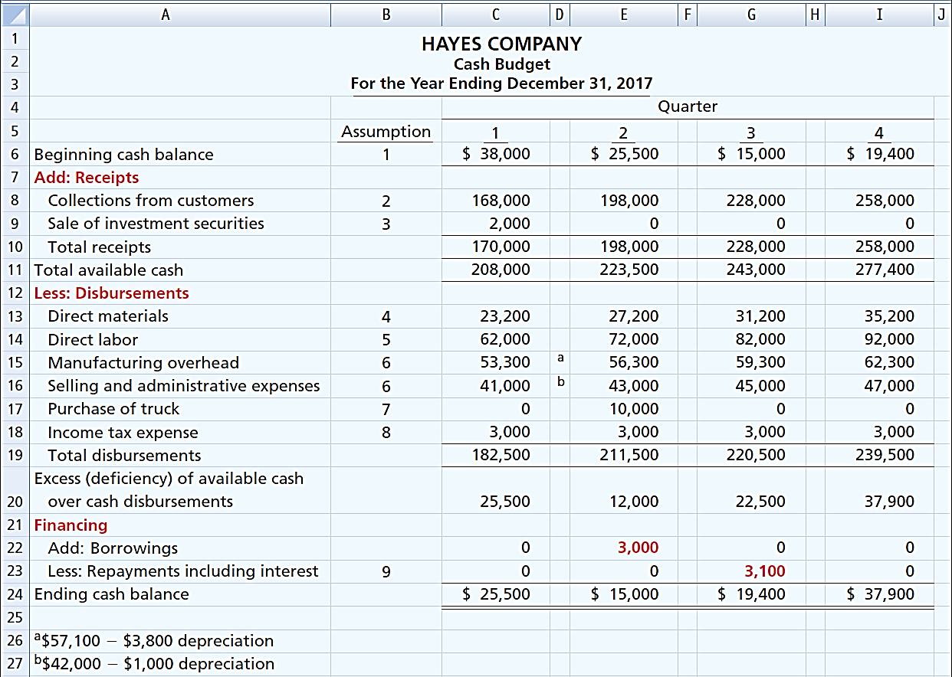

Slide 65
Budgeted Balance Sheet
Projection of financial position at the end of the budget period
Developed from the budgeted balance sheet for the preceding year and the budgets for the current year.

Slide 66
Budgeted Balance Sheet
Illustration: Pertinent data from the budgeted balance sheet at December 31, 2016, are as follows.
Buildings and equipment $182,000
Common stock 225,000
Accumulated depreciation 28,800
Retained earnings 46,480
Cash: Ending cash balance $37,900, shown in the cash budget.
Accounts receivable: 40% of fourth-quarter sales $270,000, shown in the schedule of expected collections from customers.
Finished goods inventory: Desired ending inventory 1,000 units, shown in the production budget times the total unit cost $44.

Slide 67
Budgeted Balance Sheet
Raw materials inventory: Desired ending inventory 1,020 pounds, times the cost per pound $4, shown in the direct materials budget.
Buildings and equipment: December 31, 2016, balance $182,000, plus purchase of truck for $10,000.
Accumulated depreciation: December 31, 2016, balance $28,800, plus $15,200 depreciation shown in manufacturing overhead budget and $4,000 depreciation shown in selling and administrative expense budget.

Slide 68
Budgeted Balance Sheet
Accounts payable: 50% of fourth-quarter purchases $37,200, shown in schedule of expected payments for direct materials.
Common stock: Unchanged from the beginning of the year.
Retained earnings: December 31, 2016, balance $46,480, plus net income $47,900, shown in budgeted income statement.

Slide 69
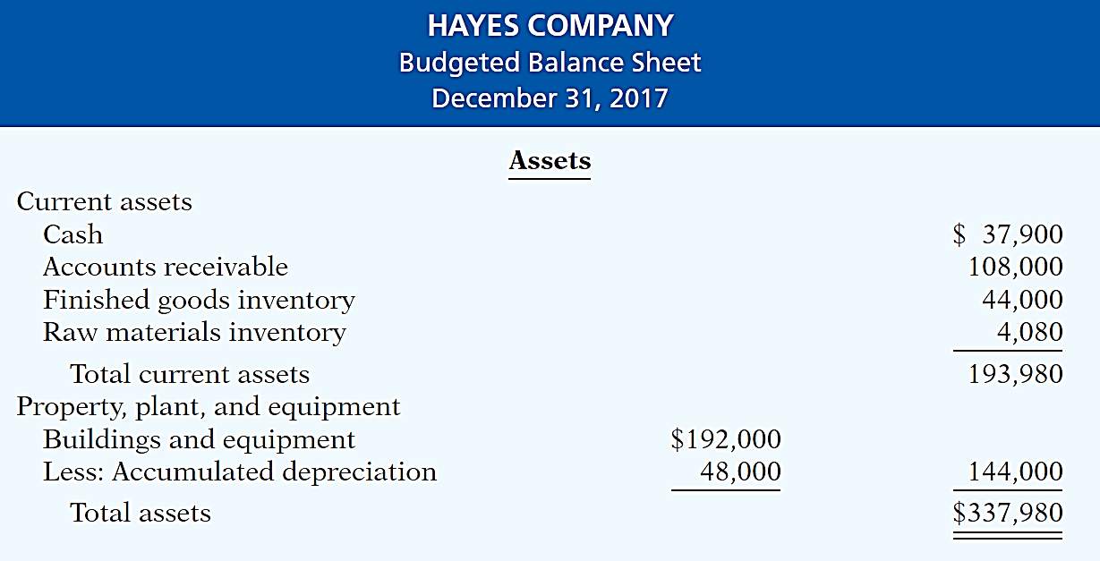
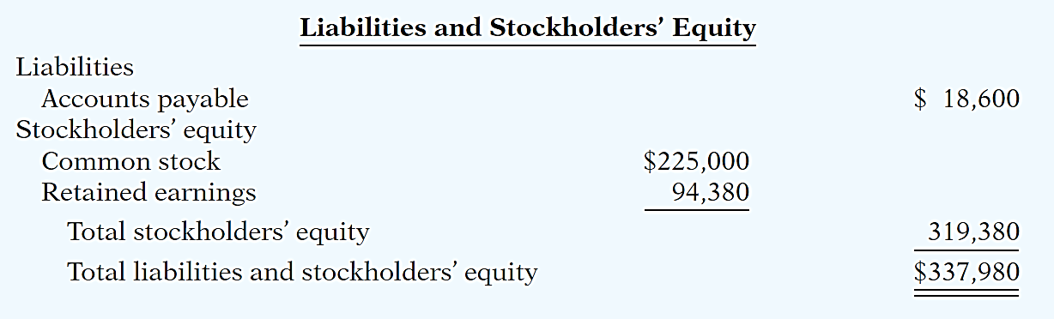

Slide 70
Budgeted Balance Sheet
Question
Expected direct materials purchases in Read Company are $70,000 in the first quarter and $90,000 in the second quarter. Forty percent of the purchases are paid in cash as incurred, and the balance is paid in the following quarter. The budgeted cash payments for purchases in the second quarter are:
a. $96,000
b. $90,000
$78,000
$72,000

Slide 71
DO IT! 4: Cash Budget
Martian Company management wants to maintain a minimum monthly cash balance of $15,000. At the beginning of March, the cash balance is $16,500, expected cash receipts for March are $210,000, and cash disbursements are expected to be $220,000. How much cash, if any, must be borrowed to maintain the desired minimum monthly balance?
Beginning cash balance | $ 16,500
Add: Cash receipts for March | 210,000
Total available cash | 226,500
Less: Cash disbursements for March | 220,000
Excess (deficiency) of available cash over cash disbursements | 6,500
Financing | 8,500
Ending cash balance | $ 15,000

Slide 72
Learning Objective 22-5
Budgeting in Nonmanufacturing Companies

Slide 73
Outline
Merchandisers
Service companies
Non-for-profit organizations

Slide 74

Merchandisers
The sales budget is starting point and key factor in developing the master budget.
Use a purchases budget instead of a production budget.
Does not use the manufacturing budgets (direct materials, direct labor, manufacturing overhead).
To determine budgeted merchandise purchases:

Slide 75
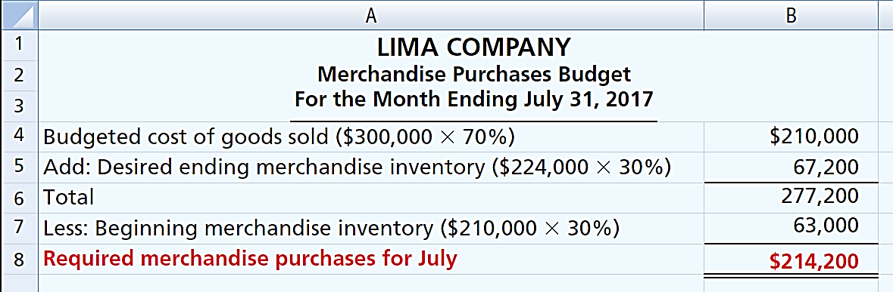
Merchandisers
Illustration: Lima estimates that budgeted sales will be $300,000 in July and $320,000 in August. Cost of goods sold is expected to be 70% of sales. The company’s desired ending inventory is 30% of the followings month’s cost of goods sold. Required merchandise purchases for July are computed as follows.

Slide 76
Service Companies
Critical factor in budgeting is coordinating professional staff needs with anticipated services.
Problems if overstaffed:
Disproportionately high labor costs.
Lower profits due to additional salaries.
Increased staff turnover due to lack of challenging work.
Problems if understaffed:
Lost revenues because existing and future client needs for services cannot be met.
Loss of professional staff due to excessive work loads.

Slide 77
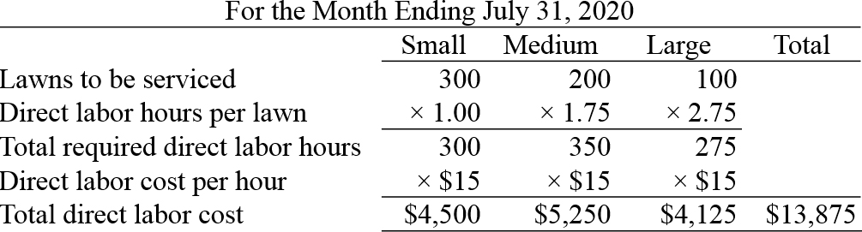
Service Companies
Direct labor budget for service company
Stephan Lawn and Plowing Service estimates that it will service 300 small lawns, 200 medium lawns, and 100 large lawns during the month of July. It estimates its direct labor needs as 1 hour per small lawn, 1.75 hours for a medium lawn, and 2.75 hours for a large lawn. Its average cost for direct labor is $15 per hour. Stephan prepares a direct labor budget as shown.

Slide 78
Not-for-Profit Organizations
Just as important as for profit-oriented company.
Budget process differs from profit-oriented company.
Budget on the basis of cash flows (expenditures and receipts), not on a revenue and expense basis.
Starting point is usually expenditures, not receipts.
Management’s task is to find receipts needed to support planned expenditures.
Budget must be followed, overspending often illegal.

Slide 79
Merchandisers
Question
The budget for a merchandiser differs from a budget for a manufacturer because:
a. A merchandise purchases budget replaces the production budget.
b. The manufacturing budgets are not applicable.
c. None of the above.
d. Both (a) and (b) above

Slide 80
DO IT! 5: Merchandisers Purchase Budget
Becker Company estimates that 2020 sales will be $15,000 in quarter 1, $20,000 in quarter 2, and $25,000 in quarter 3. Cost of goods sold is 80% of sales. Management desires to have ending finished goods inventory equal to 15% of the next quarter’s expected cost of goods sold. Prepare a merchandise purchases budget by quarter for the first six months of 2020.
 | 1st Quarter | 2nd Quarter | Six Months
Budgeted cost of goods sold (sales × .80) | $ 12,000 | $ 16,000
Add: Desired ending merchandise inventory
(15% of next quarter’s cost of goods sold) | 2,400 | 3,000
Total | 14,400 | 19,000
Less: Beginning merchandise inventory
(15% this quarter’s cost of goods sold) | 1,800 | 2,400
Required merchandise purchases | $ 12,600 | $ 16,600 | $ 29,200

